Slide 1

Digital Learning's Impact on Math
An analysis of Grade 9 mathematics achievement.
BY
Usama Umer - MSDS25044
Muhammad Ahmed - MSDS25048
Saad Ali – MSDS25066
G - 21

Slide 2

Introduction: Digital vs. Traditional
Digital learning platforms are gaining momentum in education. This study investigates their impact on Grade 9 math scores compared to traditional classroom instruction.
Research Question
Does digital learning lead to significantly higher math scores for Grade 9 students?

Slide 3
Study Participants & Data
Our dataset includes 60 Grade 9 students, split evenly between Digital and Conventional learning groups, allowing for a comparative analysis.
Student-ID
Unique identifier
Group
Digital or Conventional
Math-Score
Test score (0-100)
Gender
Male/Female
Attendance (%)
Term attendance
G - 21

Slide 4

Analytical Toolkit
Our analysis leveraged Python within Anaconda, utilizing key libraries for data manipulation, statistical testing, and visualization.
Python
Pandas
Core language for analysis.
Data manipulation & cleaning.
NumPy
SciPy
Numerical computations.
Statistical tests.
Matplotlib
Seaborn
Plotting & visualizations.
Advanced visualizations.
G - 21

Slide 5
Methodology: A Structured Approach
We followed a rigorous workflow, from data validation to hypothesis testing, to ensure robust findings.
01
02
Data Loading & Validation
Descriptive Statistics
Ensuring data quality and integrity.
Calculating mean, median, SD, and range for each group.
03
04
Hypothesis Testing
Assumption Checks
Formulating null and alternative hypotheses.
Verifying normality and homogeneity of variance.
05
06
Independent Samples t-Test
Effect Size & CI
Comparing means between digital and conventional groups.
Quantifying the magnitude and confidence of differences.
G - 21

Slide 6

Hypothesis & Assumptions
Our core hypothesis put forward a difference in math scores, rigorously tested after validating key statistical assumptions.
Null Hypothesis (H₀)
Assumption Checks (α = 0.05)
No significant difference in math achievement between digital and conventional learning.
Normality (Shapiro-Wilk): Digital (p=0.5345), Conventional (p=0.8972). Both groups are normally distributed.
Alternative Hypothesis (H₁)
Homogeneity of Variance (Levene’s): F=1.5682, p=0.2155. Equal variances assumed.
Digital learning yields significantly higher math scores.
G - 21

Slide 7
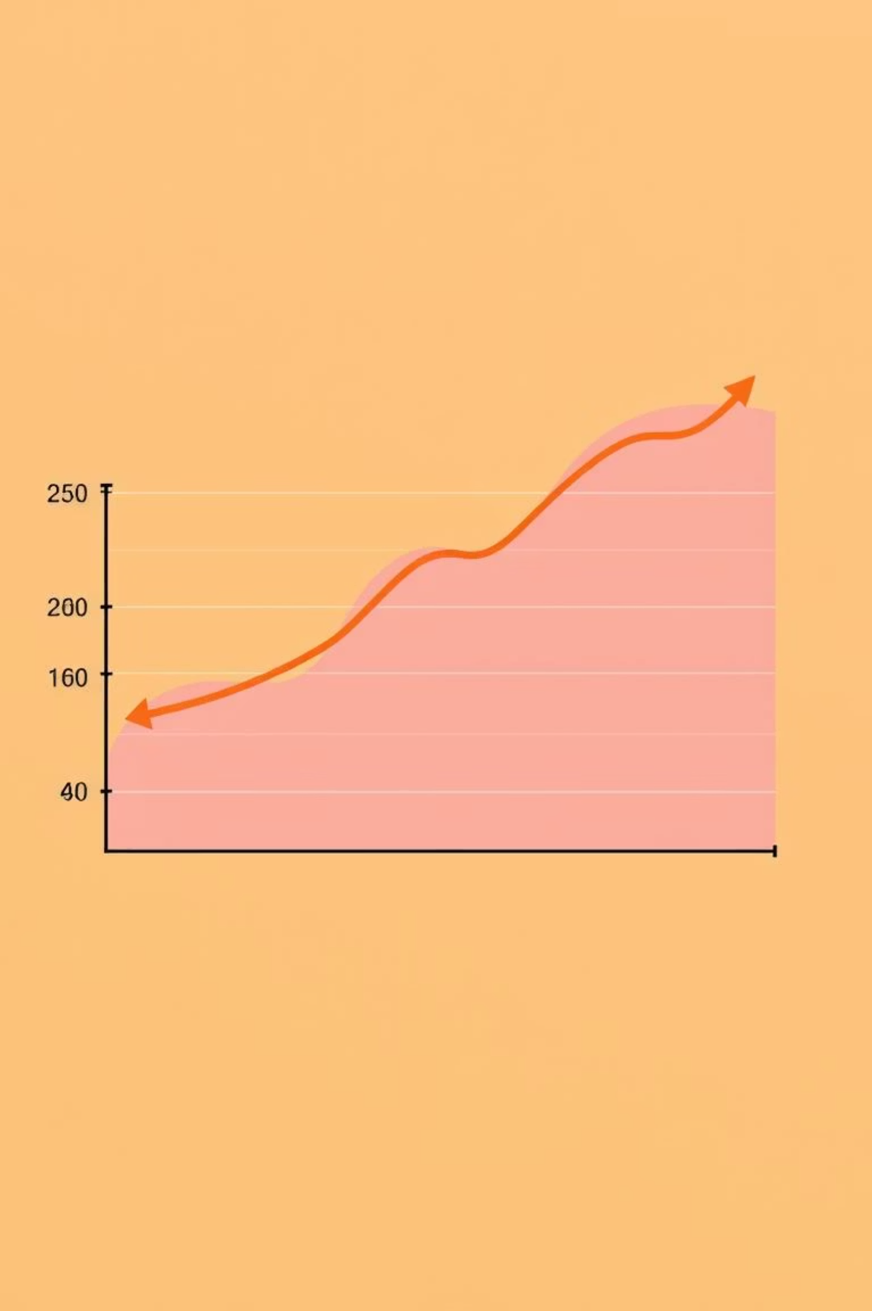
T-Test Results: Significant Difference
The independent samples t-test revealed a statistically significant difference, favoring digital learning.
t-statistic
1
Observed difference is 4.45 standard errors from zero.
p-value
2
Probability of observing this difference by chance is less than 0.01%.
Cohen's d
3
Large effect size, indicating a substantial difference.
95% CI
4
True difference in mean scores is between 3.80 and 9.80 points.
G - 21

Slide 8

Additional Insights: Gender & Attendance
Beyond math scores, we examined gender distribution and attendance, finding moderate positive correlations with math achievement.
Gender Distribution
Attendance Analysis
Digital Group: 17 Males, 13 Females
Digital Group Mean: 93.27%
Conventional Group Mean: 91.07%
Conventional Group: 18 Males, 12 Females
Difference: 2.20% higher in digital group.
Correlation (Digital): r = 0.388 (moderate positive)
Correlation (Conventional): r = 0.494 (moderate positive)
G - 21

Slide 9
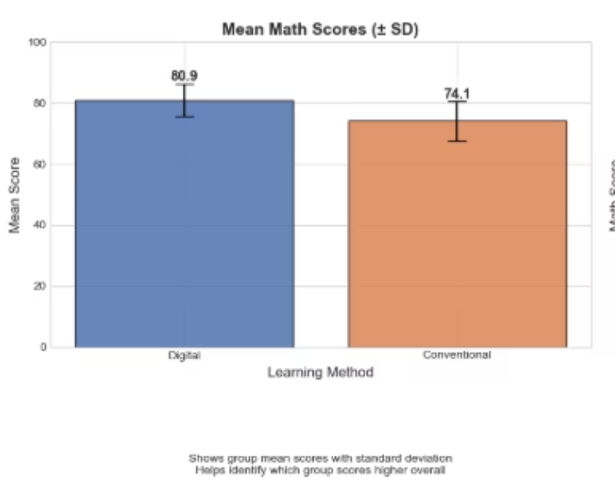
Visualizing the Data
Visualizations provide a clear picture of score distributions and correlations.
What It Shows
This bar chart displays the mean (average) math scores for two groups:
Digital group: Mean = 80.9 (blue bar)
Conventional group: Mean = 74.1 (orange bar)
Key Features
Error Bars (± SD): The black lines extending from the top of each bar represent the standard deviation, which shows how spread out the scores are:
Digital group: Larger error bar = greater variability in student scores
Conventional group: Smaller error bar = more consistent scores among students
What This Means
Digital learning wins on average: Students in the digital group scored about 6.8 points higher (80.9 vs 74.1)
But with more variability: The digital group's larger standard deviation means:
Some students did exceptionally well
Some students struggled more
Overall, there's a wider range of outcomes
Conventional learning is more consistent: Students' scores clustered more tightly around the mean
These charts illustrate the positive impact of digital learning on math scores and the relationship with attendance.
G - 21

Slide 10
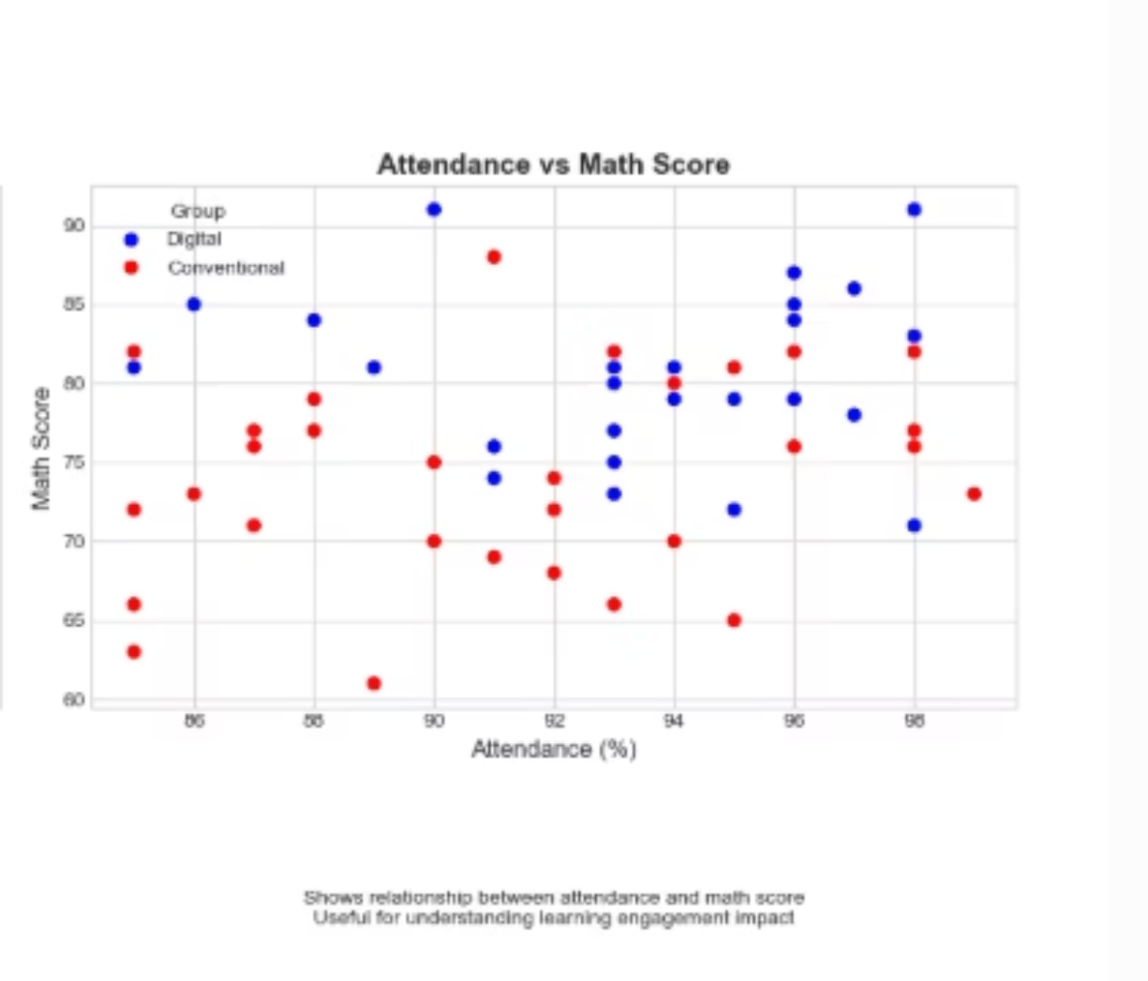
Visualizing the Data
Attendance vs Math Score Graph - Key Points
What the graph shows:
Each dot represents one student
Blue dots = Digital group students
Red dots = Conventional group students
X-axis = Attendance percentage (80-100%)
Y-axis = Math scores (60-95)
Key findings:
No clear correlation: Attendance does NOT strongly predict math scores in either group—students with similar attendance show widely varying performance
Digital group clusters higher: Blue dots concentrate in the 75-95 score range, while red dots cluster in the 65-85 range, confirming Digital's superior performance
Both groups have similar attendance: Students from both methods attend at comparable rates (mostly 85-100%), so attendance differences don't explain the performance gap
Wide score variation at high attendance: Even among students with 95%+ attendance, math scores vary dramatically (from 70 to 95), suggesting attendance alone doesn't guarantee success
Implication: The Digital method's effectiveness isn't due to better attendance—it's the quality of the learning approach itself that drives higher achievement
Practical insight: Simply increasing attendance won't close the performance gap; the teaching method matters more
G - 21

Slide 11
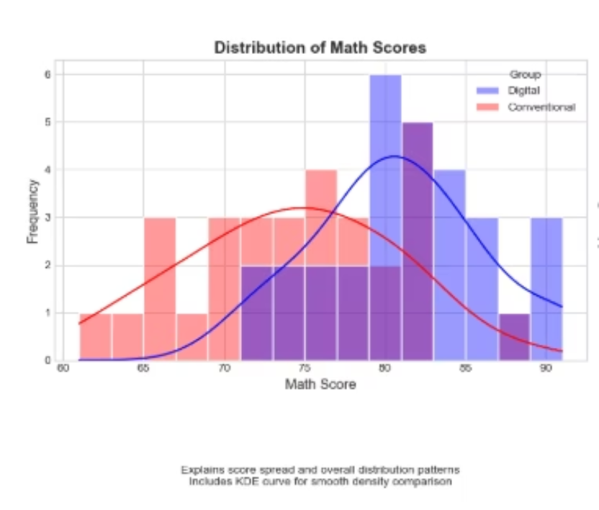
Visualizing the Data
Distribution of Math Scores - Explanation
What the graph shows:
Overlapping histograms comparing score distributions between Digital (pink/salmon) and Conventional (blue/purple) groups
Black curve = theoretical normal distribution overlay
X-axis = Math scores (60-90)
Y-axis = Frequency (number of students)
Key observations:
Digital group (pink) centers around 80-82: The peak frequency shows most Digital students scored in this higher range
Conventional group (blue) centers around 74-76: The peak is shifted left, indicating lower average performance
Digital shows wider spread: Pink bars extend more broadly across the score range, indicating greater variability in student outcomes (some very high, some moderate)
Conventional shows tighter clustering: Blue bars are more concentrated around the mean, indicating more consistent but lower performance
Overlap exists: Both distributions overlap significantly in the 70-85 range, meaning some students performed similarly regardless of method
Distribution shapes differ: Digital approximates normal distribution (fits the black curve better), while Conventional is more peaked and compact
Bottom line: While the overlapping distributions might initially look similar, the Digital group's distribution is shifted rightward (higher scores) with more variability, while the Conventional group shows more uniform but lower achievement—confirming your statistical finding of significantly higher Digital performance.
G - 21

Slide 12

Conclusion & Future Directions
Digital learning significantly enhances Grade 9 math achievement, with a large practical impact. Further research is needed to optimize implementation.
Reject Null Hypothesis
Practical Significance
Digital learning leads to higher math scores (p < 0.05).
Large effect size (Cohen's d=1.17) suggests meaningful real-world impact.
Future Research
Randomized trials, effective platform features, and cost-effectiveness.
G - 21

